Slide 1
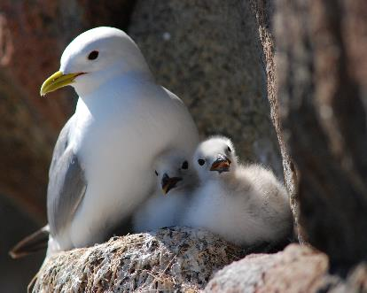
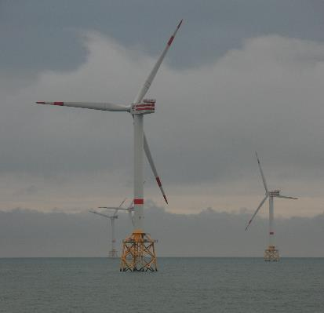
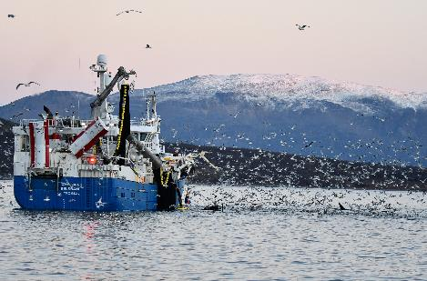
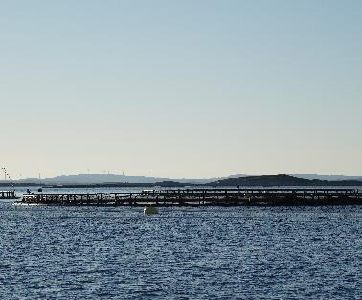
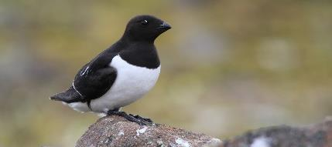
MARCIS – marine spatial planning and cumulative impacts of blue growth on seabirds
Tools for assessing the impact of marine industries on seabirds
The growth of coastal and marine industries has led to increasing pressure on marine biodiversity. Consequently, there is an urgent demand for novel management tools to ensure sustainable industrial development in the marine environment.
Seabirds play an important role in marine ecosystems and are among the most threatened birds in the world, partly due to anthropogenic activities.
The goal of MARCIS is to develop a decision support tool (MARCIS app) for assessing the cumulative impact of human marine industries on seabirds and migrating land birds in marine ecosystems.

Slide 2







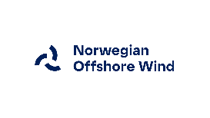


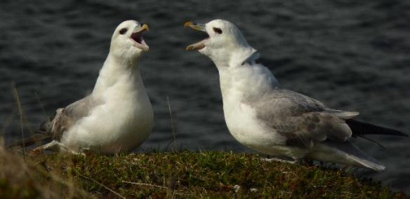
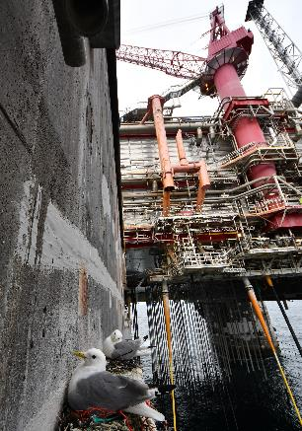

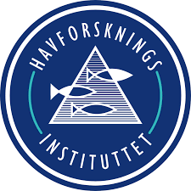


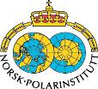

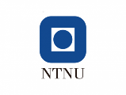
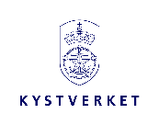




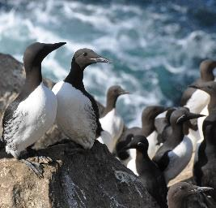
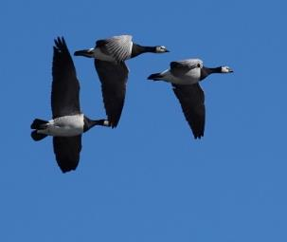




MARCIS – Project Collaborators
MARCIS is a collaborative research project between research institutes, industry, management authorities, NGOs and interest groups. The project will contribute to ecosystem-based management of marine spatial use and provide a decision-support tool for balancing interests and conflicts in planning processes.

